Slide 1


IOT#BC
Studenti
Paolo Campanelli
Andrea Cataluffi
Prof.
Massimo Callisto De Donato

Slide 2
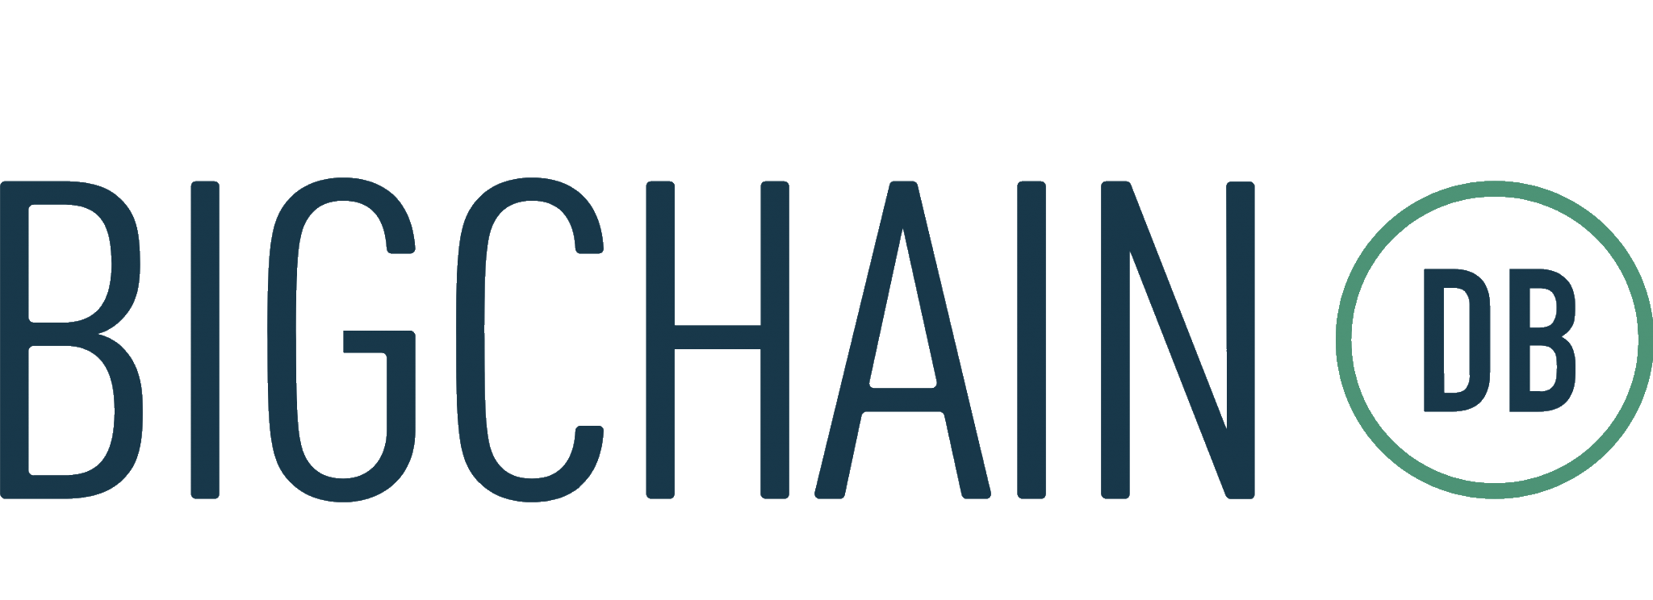
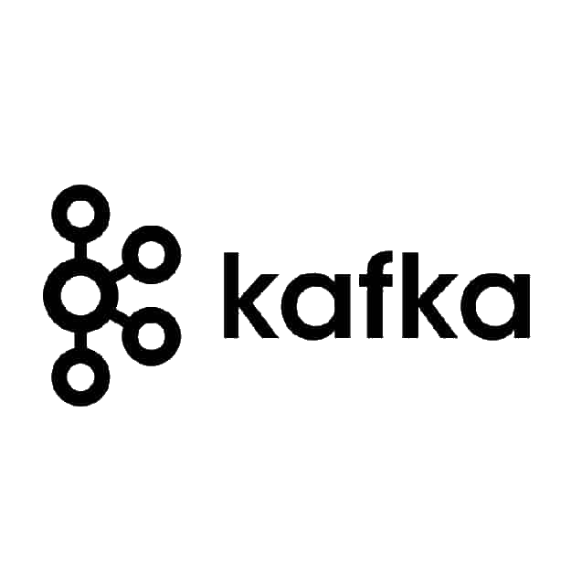
Objective
The objective of our project is to define a prototype tool to store IoT data on a blockchain database based on BigchainDB
In order to guarantee scalability and performance, we introduce an additional message broker component based on Apache Kafka

Slide 3
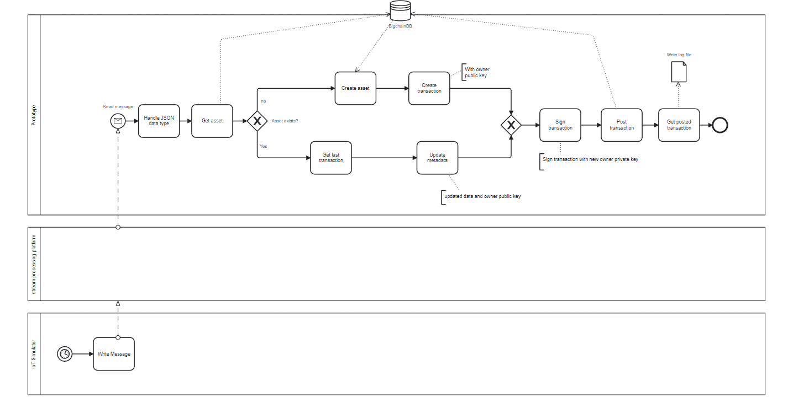
Architecture
IoT simulator (su Ubuntu 20.04)
Kafka (su Ubuntu 20.04)
NodeJs (su Ubuntu 20.04)
BigchainDB Server (su debian 11.0)

Slide 4
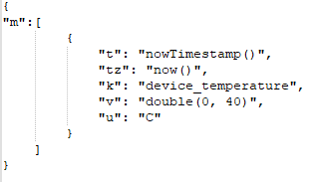
IoT Simulator
Used to simulate IoT devices that send JSON messages to the Kafka broker.
cd docker-compose
docker compose up

Slide 5
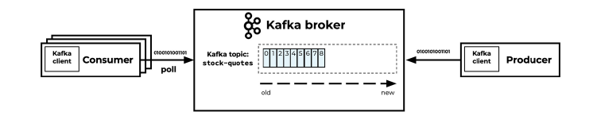
Kafka
Receives the JSON messages from the IoT devices and stores them in topics
Whether you are looking to process data from IoT devices, to handle data pipelines in big data processing applications, or to provide real-time data feeds for data visualization and analysis, Apache Kafka is a highly effective solution that is well-suited to meet your needs
Apache Kafka provides native support for MQTT, allowing MQTT data to be processed and stored using the Kafka platform.

Slide 6
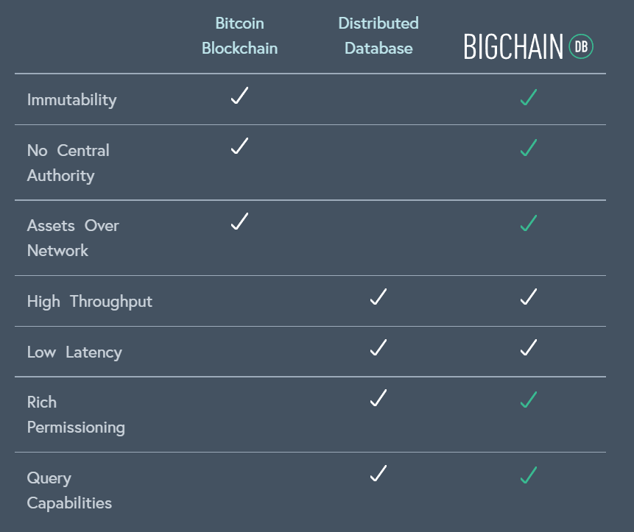
BigchainDB combines the key benefits of distributed database, MongoDB, and traditional blockchain
BigchainDB starts with a big data distributed database and then adds blockchain characteristics - decentralized control, immutability and the transfer of digital assets.

Slide 7
Terminology
BigchainDB Node: is a machine running Bigchain Server and related software. Each node is controlled by one person or organization.
BigchainDB Network: A set of BigchainDB nodes can connect to each other to form a BigchainDB network. Each node in the network runs the same software. A BigchainDB network may have additional machines to do things such as monitoring.
BigchainDB Consortium: The people and organizations that run the nodes in a BigchainDB network belong to a BigchainDB consortium. A consortium must have some sort of governance structure to make decisions.
Notes:
If a BigchainDB network is run by a single company, then the “consortium” is just that company.
What’s the Difference Between a BigchainDB Network and a Consortium?
A BigchaindB network is just a bunch of connected nodes. A consortium is an organization which has a BigchainDB network, and where each node in that network has a different operator.

Slide 8
Properties of BigchainDB
Decentralization
Byzantine Fault Tolerance
Node Diversity
Immutability

Slide 9
Decentralization and Consortium in BigchainDB
Decentralization means no single entity has complete ownership or control, and there is no single point of failure.
Ideally, each node in a BigchainDB network is owned and controlled by a different person or organization.
A "BigchainDB consortium" refers to the set of people and/or organizations who run the nodes of a BigchainDB network, which requires decentralized governance.
Consortium can increase its decentralization by increasing jurisdictional and geographic diversity.
All nodes in the network run the same software and perform the same duties.
Admin access to a node only allows for changes to that node's data, and the network can only be compromised if more than one-third of the nodes are compromised.

Slide 10
Byzantine Fault Tolerance (BFT)
Byzantine Fault Tolerance (BFT) is a characteristic of distributed systems that ensures they can operate correctly in the presence of faulty or malicious nodes.
BFT algorithms are designed to tolerate Byzantine faults, where a node may send different information to different nodes in the network.
The goal of BFT is to reach consensus among nodes on the state of the system, even if some nodes are malicious or fail to respond.
In BigChain we use Tendermint that is a a BFT algorithms which requires at least ⅓ of the nodes to be compromised before the network can be compromised.

Slide 11
Node Diversity
To make it difficult for any one actor or event to control or damage enough of the nodes, diversity is crucial.
Jurisdictional diversity ensures that nodes are controlled by entities within multiple legal jurisdictions, making it difficult to use legal means to compel enough nodes to act in a particular way.
Geographic diversity ensures that nodes are physically located in different locations, reducing the impact of natural disasters.
Hosting diversity ensures that nodes are hosted by multiple providers, reducing the influence of any one provider.
Diversity in general, including membership diversity, provides a source of various ideas for addressing challenges, and confers many advantages on a consortium.
Achieving high diversity in all areas can be challenging but is necessary to ensure the resilience of the network.

Slide 12
Immutability
Blockchain data is practically immutable, meaning it is more difficult to change or delete than usual.
No APIs are exposed for changing or deleting blockchain data, but it doesn't prevent changes or deletions from happening in other ways.
Replication is used to make it difficult to change or delete all replicas of the data, and all nodes monitor all changes to detect unallowed changes.
External watchdogs can be used to audit data irregularities, and economic incentives can make it expensive to change old stored data.
Cryptographic signatures are used to verify the authenticity and integrity of transactions in BigchainDB.
Full or partial backups can be recorded from time to time to prevent data loss, and node owners can adopt strong security policies to enforce data integrity.

Slide 13
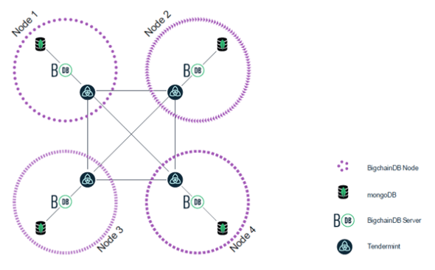
BC Architecture

Slide 14
Data Structure
BigchainDB storage solution is composed by two distributed databases
Database S, also known as transaction set or backlog. It collects the transactions generated by the clients and not yet validated.
Database C, also known as blockchain. It contains valid and invalid transactions, grouped into blocks logically linked to each other
Notes:
The use of two distributed databases allows to obtain a high transactions throughput, these two databases are not completely replicated in each node of the network. They are split in smaller portions, called shards, replicated a given number of times by a subset of all the participants.
Adding nodes to this distributed system implies increasing the amount of data that can be globally stored but the nodes of the network cannot execute operations based on their own local replica of data, because it is necessary to merge all the shards owned by different participants to obtain an overall view of stored data.

Slide 15
BigchainDB Consensus Algorithm
BCA is executed by a well-known set of nodes of the network that decides if the transactions can be considered valid or not
This classification is executed according to a voting mechanism strictly related to the concept of quorum
The consensus mechanism is triggered by the generation of new transactions executed by clients of the network
Notes:
Unlike the other blockchain platforms, blocks do not contain the hash of the previous block of the chain in their header. For each transaction contained in the block it is stored a reference to the previous block.
Each block contains a set of transactions that must be voted by the nodes of the network to decide if the content of the transactions can be considered valid or not.
The voting nodes attach to every transaction of the block the hash of the previous block of the chain. This is fundamental to demonstrate the transaction has been voted according to the current state of the blockchain, identified by the previous block.

Slide 16
How it work?
One node of the network receives a new transaction and verifies if it can be considered potentially valid and if it is, n1 stores the transaction in the backlog S and notifies another node of the network (n2) that manages that transaction
Node n2 collects a set of transactions stored in S, and creates a block. This block is persisted into the blockchain database C, and contains only transactions that must be validated. For this reason, the new block is classified as undecided
To execute the validation of blocks, voting nodes check the validity and express a vote for every transaction contained therein. Each vote is relative to a single transaction and it is composed by the hash of the previous block and by the voting decision. The transaction can assume only two values, valid or invalid
When the majority of voters agrees on the validity or not of a transaction, the transaction is classified. It is sufficient that only one transaction of the new block is considered invalid to categorize the whole block as decided invalid, otherwise it is marked as decided valid
All the transactions contained in a decided valid block are committed, while all the transactions of a decided invalid block do not affect the state of the ledger. If a decided invalid block contains some valid transactions, they are stored again in S so that they can be inserted in another block and committed. Valid and invalid blocks will never be removed from C

Slide 17
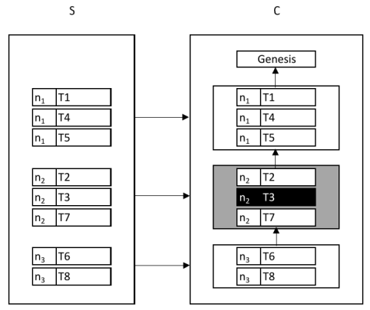
Visual Example
White background blocks are valid blocks, Grey background are invalid blocks and Black background indicates an invalid transaction stored in C.
Backlog S contains 8 transactions (T1, T2,..., T8 )
Network is composed by three nodes, n1, n2, n3
The node n1 creates a block containing the transactions T1, T4, T5.
The majority of nodes voted as valid these three transactions, and therefore the block 1 has been marked as decided valid.
Block 2 is created by node n2 and contains the transactions T2, T3 and T7.
The transaction T3 has been considered as invalid, so the correspondent block has been marked as decided invalid but it has not been removed from the chain of blocks
Notes:
Database S, also known as transaction set or backlog. It collects the transactions generated by the clients and not yet validated.
Database C, also known as blockchain. It contains valid and invalid transactions, grouped into blocks logically linked to each other
For this reason, the third block (block 3 ) contains a set transactions that refer to block 2 as the previous block of the chain. After the transactions have been inserted in valid blocks, they are removed from the backlog.

Slide 18
Not ACID But SALT
ACID referes to a set of guarantees for each transaction to be processed by the TP system: Atomicity, Consistency, Isolation, and Durability.
SALT is about Sequential, Agreed-on, Ledger, and Tamper-resistant transaction processing.
Notes:
Sequential : All Transaction are processed sequentially. Unlike with ACID transaction there is no parallel processing of transaction in the SALT model. However, just like the isolation property in ACID, all transaction in sequential order
Agreed-on : A Transaction is accepted when the majority of the network agrees on its valid. Community consensus determinies the system state, unlike in ACID,where it is solely controlled by a central authority
Ledger : All agreed-on Transaction are added to an append-only transaction ledger and cannot be revoked. State changes cannot be undone. This property is a bit weaker than the durability in ACID
Tamper-resistant : A Transaction cannot be manipulated or censored. Unlike the ACID there is no central access management so there are no privileged users which could alter or block pending transactions

Slide 19
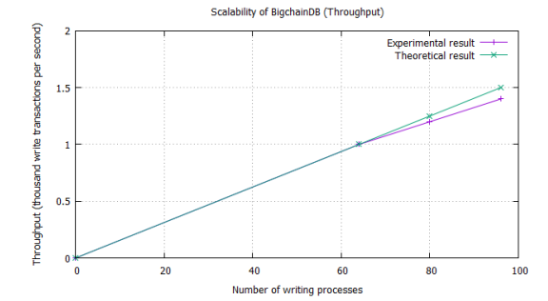
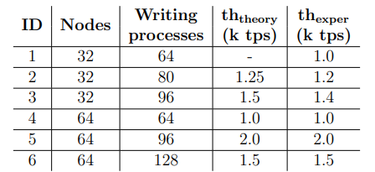
Throughput
The throughput of BigchainDB varies from 1000 to 2000 writing transactions per second, tests conducted on a cluster of 32 and 64 nodes.
The performances are strictly related to the number of processes simultaneously writing to the databases.

Slide 20
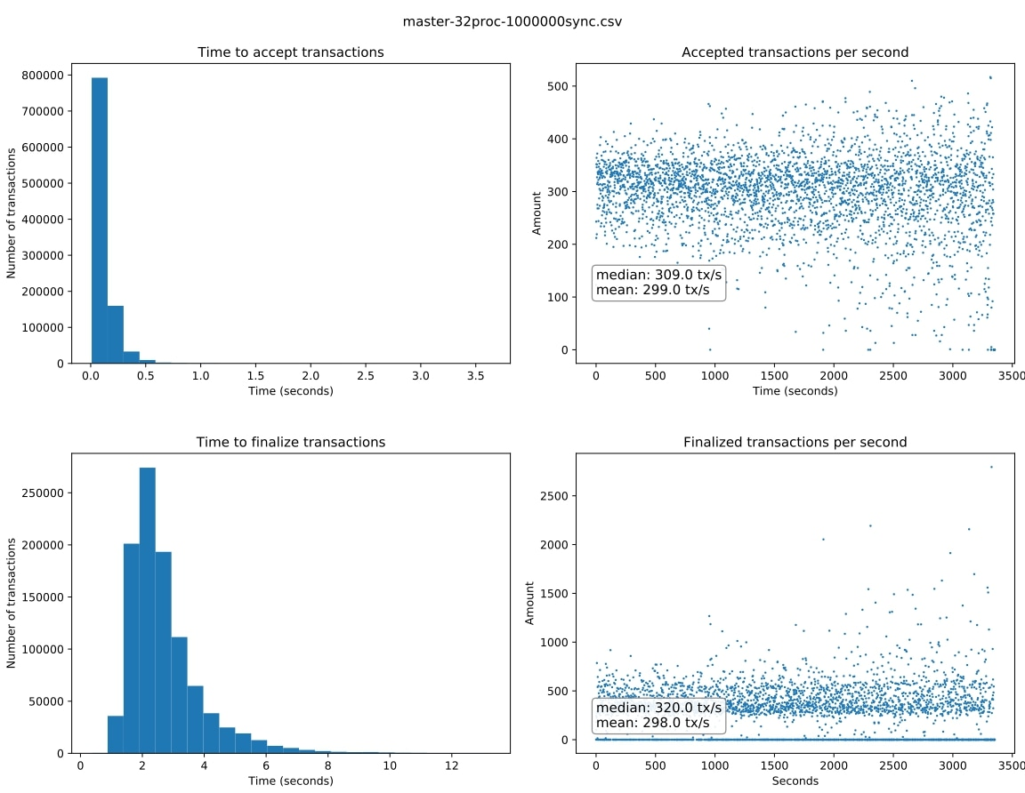
Throughput’s Experiment
One million transactions were processed in about 56 minutes without any failure.
99.7% of transactions were finalized within 9.392 seconds, 95% within 5.143 seconds, and 68% within 2.855 seconds.
The network finalized an average of 298 transactions per second, with a median value of 320 transactions per second.
All transactions were 765 bytes.
https://github.com/bigchaindb/BEPs/blob/master/23/README.md

Slide 21
Pros and Cons
Pros
High throughput.
Low latency.
Finality of transactions.
High storage capabilities (linearly dependent n the number of nodes).
Full-featured query language.
High performances in read-write operations.
Cons
Impossibility to write smart contracts.
Absence of Byzantine fault tolerance (crash-tolerant consensus algorithm)

Slide 22
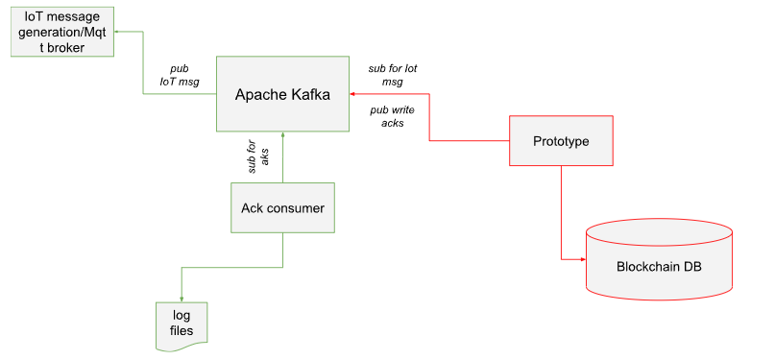
Prototype
It is created with NodeJS, you can launch it with Docker
How to run
docker-compose up

Slide 23
Libraries
AXIOS (version 1.3.2)
Bigchaindb-js-driver (version 4.3.0)
Config (version 3.3.9)
Kafkajs (version 2.2.3)
Notes:
Bigchaindb-js-driver 4.3.0 Official JavaScript driver for BigchainDB to create transactions in Node.js and the browser
AXIOS makes it easy to send asynchronous HTTP requests to REST endpoints and perform CRUD operations
Kafkajs A MODERN APACHE KAFKA CLIENT FOR NODE.JS
Config Node-config organizes hierarchical configurations for your app deployments.

Slide 24
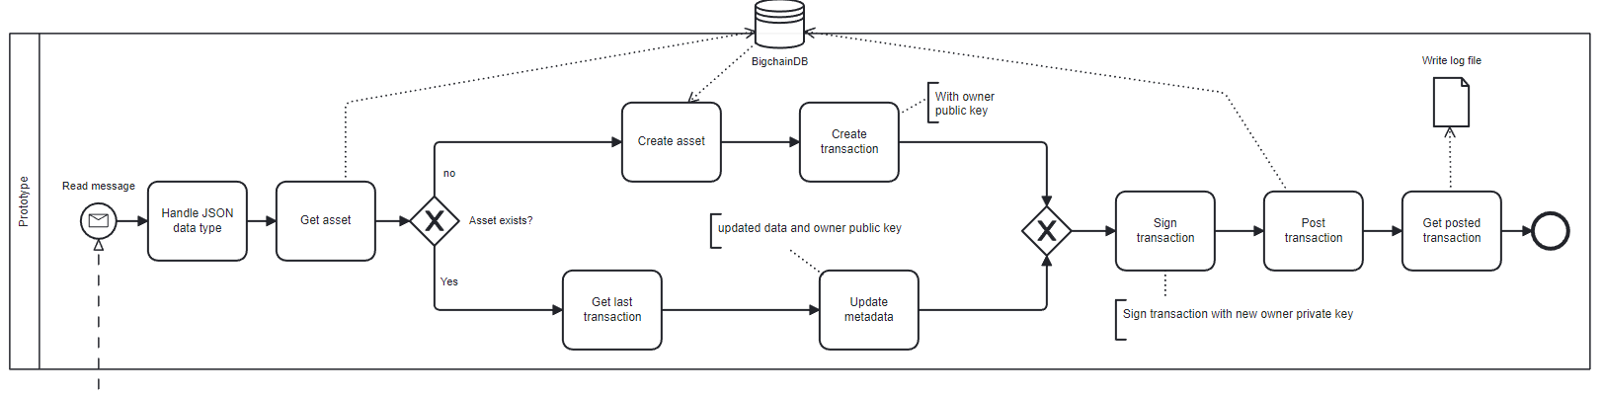
Logic
Notes:
This is the basic concept from which we started the implementation of our prototype.
First we format the data that is sent to us, then we take the asset corresponding to the data.
Whether the asset exists is evaluated. If it exists, it means that we definitely have a transaction already stored and consequently we will create a TRANSFER transaction.
Otherwise the asset is created and then a CREATE transaction is created.
Then transactions are signed with the private key and stored in BigchainDB, and a confirmation ACK is generated if the storage is successful.

Slide 25

Event Handling
Consume a message and, send it to the driver in order to create a transaction.
After that we can re-send a confirmation ACK of creating a new valid block to Apache Kafka topic.
https://github.com/tulios/kafkajs
Notes:
As we have already said, our purpose is to read high frequency data, store it in a blockchain and return a successful transaction confirmation ACK. The tool used is the KafkaJs library, A MODERN APACHE KAFKA CLIENT FOR NODE.JS This library has allowed us to create a consumer that, for each topic, reads and consumes messages and sends them to the service that will be responsible for creating and managing transactions. We also created a producer to manage the response ACK

Slide 26
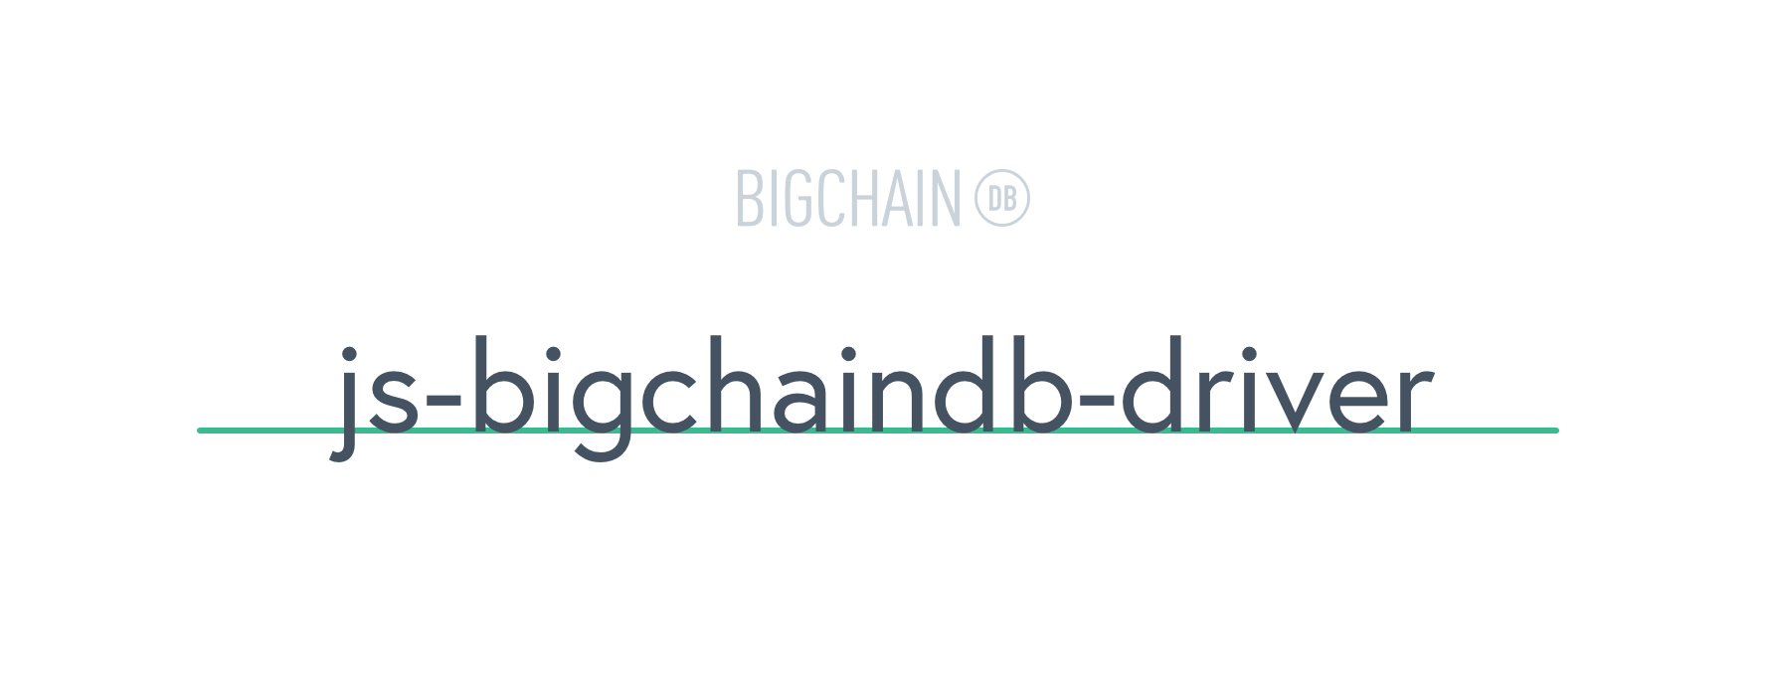
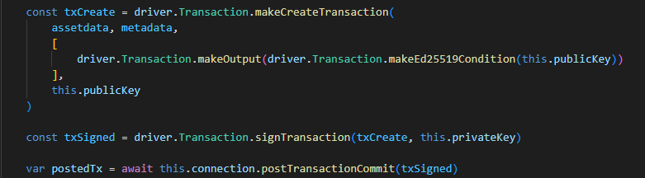
Transaction methods
Snippet to make a new CREATE transaction
https://github.com/bigchaindb/js-bigchaindb-driver
Notes:
This is an extract of code to show how a CREATE transaction is created.
We use the makeCreateTransaction method to build the payload transaction where we go to specify assets, metadata, transaction output and the owner’s public key.
ì
As we mentioned earlier the transaction then is signed with the owner’s private key.
We can eventually define our signature function but for our system it is not necessary.
After signing the transaction the connection with bigcahinDB is opened and the transaction post is made.

Slide 27
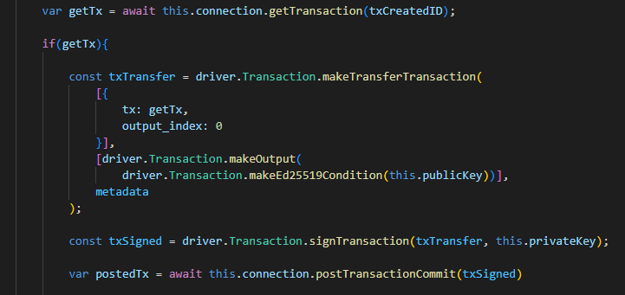
Transaction methods
Snippet to make a new TRANSFER transaction
https://github.com/bigchaindb/js-bigchaindb-driver
Notes:
In our case we do not have a real transfer of ownership of the transaction but simply a Transfer action to update the metadata value.
As a result, when we receive a new message we will only modify the block metadata by updating its value.
First, we’re going to retrieve the old transaction.
Starting from the recovered transaction we go to make a TRANSFER in order to update its value. Then the transaction is signed with our private key and posted to the server.

Slide 28
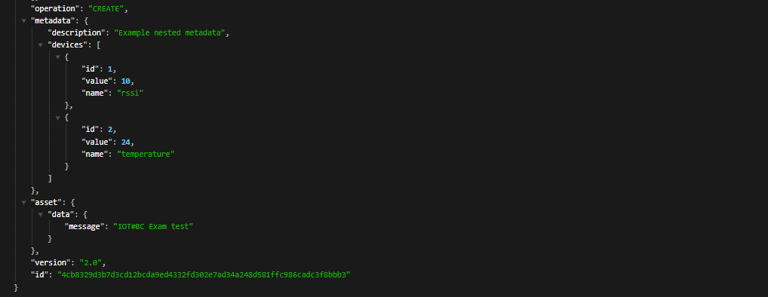
Transaction methods
Snippet to make a new CREATE transaction
https://github.com/bigchaindb/js-bigchaindb-driver
Notes:
This is an extract of code to show how a CREATE transaction is created.
We use the makeCreateTransaction method to build the payload transaction where we go to specify assets, metadata, transaction output and the owner’s public key.
ì
As we mentioned earlier the transaction then is signed with the owner’s private key.
We can eventually define our signature function but for our system it is not necessary.
After signing the transaction the connection with bigcahinDB is opened and the transaction post is made.

Slide 29
…and what if, if methods are not enough?

Slide 30

APIs
E.G.
Get a list of transactions that use an asset with the ID asset_id.
GET /api/v1/transactions?asset_id={asset_id}&operation={CREATE|TRANSFER}&last_tx={true|false}
Query Parameters
operation (string) – (Optional) CREATE or TRANSFER.
asset_id (string) – asset ID.
last_tx (string) – (Optional) true or false.
https://github.com/axios/axios
Notes:
This feature has not been made available directly by the driver but is still accessible using the REST API.
In our case it was useful to simply derive the last transaction for an asset.

Slide 31
Conclusion
Future work
Be able to handle other data formats in input
Implement all APIs to simplify the use of the driver in NodeJS, making them open-source to make them available
Manage multiple devices and multiple outputs.
In our case for simplicity, we managed only one "device" that sent more data, and for each data we created an asset and its blocks.
The JavaScript driver was not as thoroughly developed as the others, e.g. Python, so we integrated custom API in order to archive a result.

Slide 32
Thanks for the attention
Studenti
Paolo Campanelli
Andrea Cataluffi
Prof.
Massimo Callisto De Donato

